Slide 1
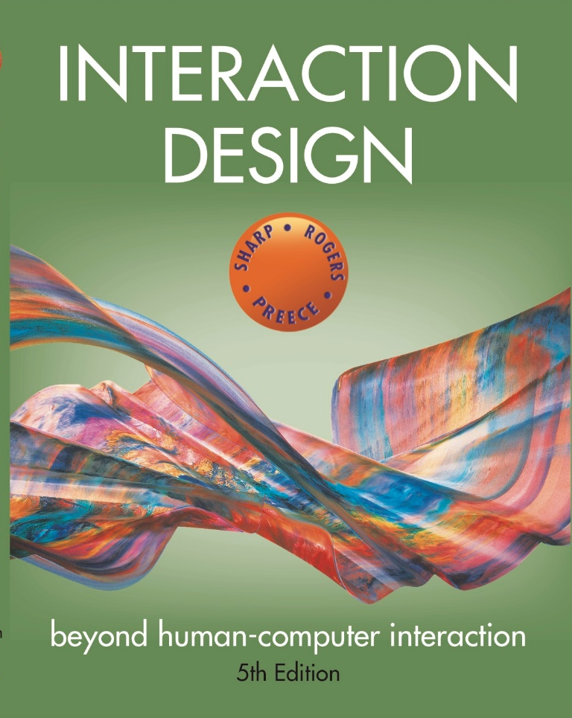
Chapter 2
THE PROCESS OF INTERACTION DESIGN

Slide 2
Overview
What is involved in Interaction Design?
Understanding the problem space
Importance of involving users
Degrees of user involvement
What is a user-centered approach?
Four basic activities of interaction design
A simple lifecycle model for interaction design
Some practical issues
Who are the users?
What are the users’ needs?
How to generate alternative designs
How to choose among alternative designs
How to integrate interaction design activities within other lifecycle models

Slide 3
What is involved in Interaction Design?
It is a process:
Focused on discovering requirements, designing to fulfil requirements, producing prototypes and evaluating them
Focused on users and their goals
Involves trade-offs to balance conflicting requirements
Generating alternatives and choosing between them is key
Four approaches: user-centered design, activity-centered design, systems design, and genius design

Slide 4
The double diamond of design
Source: Adapted from https://www.designcouncil.org.uk/news-opinion/design-process- what-double-diamond

Slide 5
Understanding the problem space
Explore:
What is currently the user experience
Why is a change needed
How will this change improve the situation
Articulating the problem space
Team effort
Explore different perspectives
Avoid incorrect assumptions and unsupported claims

Slide 6
Importance of involving users
Expectation management
Realistic expectations
No surprises, no disappointments
Timely training
Communication, but no hype
Ownership
Make the users active stakeholders
More likely to forgive or accept problems
Can make a big difference to acceptance and success of product

Slide 7
Degrees of user involvement
Member of the design team
Full time: constant input, but lose touch with users
Part time: patchy input, and very stressful
Short term: inconsistent across project life
Long term: consistent, but lose touch with users
Face-to-face group individual or activities
Online contributions from thousands of users
Online Feedback Exchange (OFE) systems
Crowdsourcing design ideas
Citizen science
User involvement after product release

Slide 8
What is a user-centered approach?
User-centered approach is based on:
Early focus on users and tasks: directly studying cognitive, behavioral, anthropomorphic & attitudinal characteristics
Empirical measurement: users’ reactions and performance to scenarios, manuals, simulations & prototypes are observed, recorded and analysed
Iterative design: when problems are found in user testing, fix them and carry out more tests

Slide 9
Four basic activities of Interaction Design
Discovering requirements
Designing alternatives
Prototyping alternative designs
Evaluating product and its user experience throughout

Slide 10
A simple interaction design lifecycle model
Exemplifies a user-centered design approach

Slide 11
Another lifecycle model: Google Design Sprints (Knapp et al, 2016)
Source: www.agilemarketing.net/google-design-sprints/ Used courtesy of Agile Marketing

Slide 12
Another lifecycle model: Research in the Wild (Rogers and Marshall, 2017)
A framework for research in the wild studies
Source: Rogers and Marshall, 2017, p6. Used courtesy of Morgan & Claypool

Slide 13
Some practical issues
Who are the users?
What are the users’ needs?
How to generate alternative designs
How to choose among alternatives
How to integrate interaction design activities with other lifecycle models

Slide 14
Who are the users/stakeholders?
Not obvious:
382 distinct types of users for smartphone apps (Sha Zhao et al, 2016)
Many products are intended for use by large sections of the population, so user is “everybody”
More targeted products are associated with specific roles
Stakeholders
Larger than the group of direct users
Identifying stakeholders helps identify groups to include in interaction design activities

Slide 15
What are the users’ needs?
Users rarely know what is possible
Instead:
Explore the problem space
Investigate who are the users
Investigate user activities to see what can be improved
Try out ideas with potential users
Focus on peoples’ goals, usability and user experience goals rather than expect stakeholders to articulate requirements

Slide 16
How to generate alternatives
Humans tend to stick with something that works
Considering alternatives helps identify better designs
Where do alternative designs come from?
‘Flair and creativity’: research and synthesis
Cross-fertilisation of ideas from different perspectives
Users can generate different designs
Product evolution based on changing use
Seek inspiration: similar products and domain, or different products and domain
Balancing constraints and trade-offs

Slide 17
How to choose among alternatives
Interaction design focuses on externally visible and measurable behaviour
Technical feasibility
Evaluation with users or with peers
Prototypes not static documentation because behaviour is key
A/B Testing
Online method to inform choice between alternatives
Nontrivial to set appropriate metrics and choose user group sets
Quality thresholds:
Different stakeholder groups have different quality thresholds
Usability and user experience goals lead to relevant criteria

Slide 18
How to integrate interaction design activities within other models
Integrating interaction design activities in lifecycle models from other disciplines needs careful planning
Software development lifecycle models are prominent
Integrating with agile software development is promising because
it incorporates tight iterations
it champions early and regular feedback
it handles emergent requirements
it aims to strike a balance between flexibility and structure

Slide 19
Some key points
Four basic activities in interaction design process
Discovering requirements
Designing alternatives
Prototyping
Evaluating
User-centered design rests on three principles
Early focus on users and tasks
Empirical measurement using quantifiable & measurable usability criteria
Iterative design

